Slide 1
Towards an More Open Northampton
Dr Ming Nie and Prof Ale Armellini
Institute of Learning & Teaching in HE
University of Northampton

Slide 2
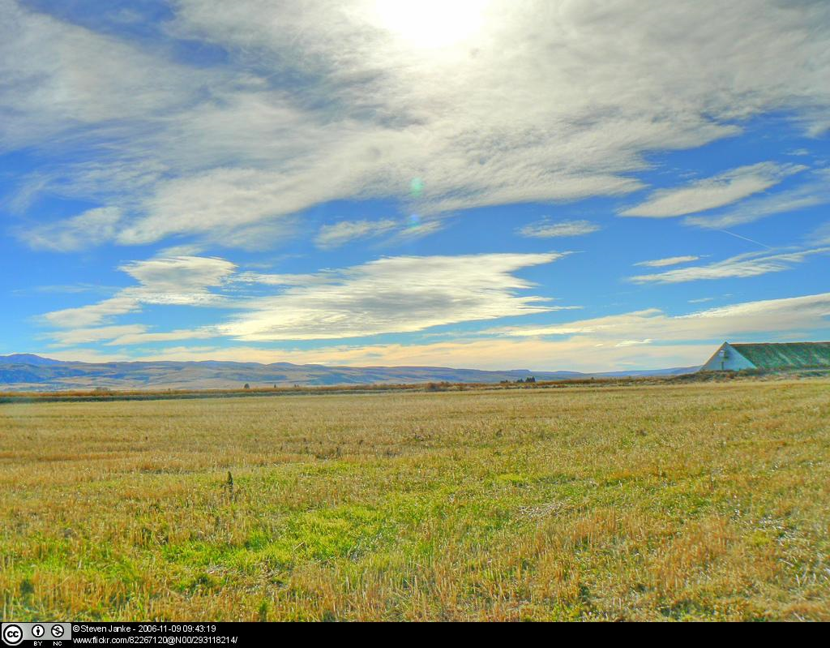
Open
Northampton
Release samples from Northampton’s learning and teaching material as OER
Release one OER from each subject area by July 2014
Institute of Learning and Teaching in HE
http://www.northamptonilt.com/open-northampton

Slide 3
Subject areas
School | Number of Subjects
Arts | 10
Business | 7
Education | 5
Health | 8
Science & Technology | 4
Social Sciences | 7
Total | 41

Slide 4
Why Open Northampton?
Scale up:
Shift to:
Re-design for online and blended provision
CPD and accreditation
Open practices
Appropriate ‘blends’
Flexibility
Mobility
Openness

Slide 5
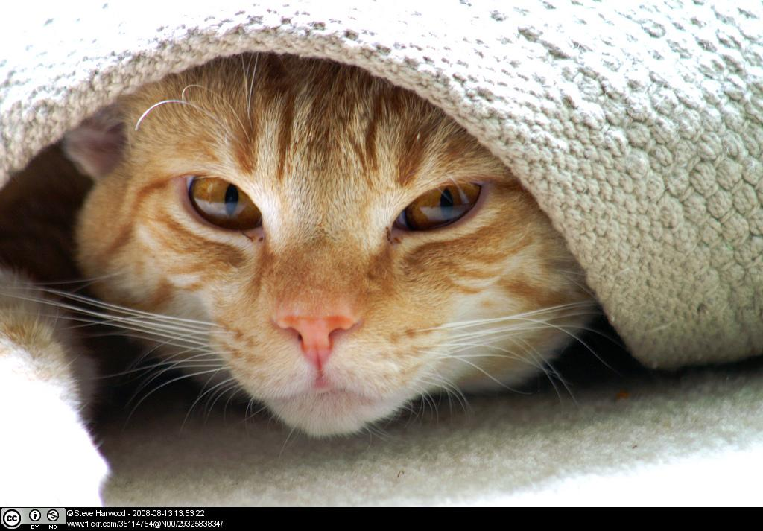
Why openness?
Enhancing student experience and satisfaction
Increasing reputation
Marketing - attracting students to specific courses of study through ‘tasters’
Achieving financial sustainability

Slide 6
How can I contribute?
What we need from you?
The materials can come in different sizes and formats, such as: Content of a teaching session or unit (in Word or PDF) Lecture presentations (in PowerPoint or PDF) Video clips Audio clips Assessment activities Learning activities Case studies & scenarios

Slide 7
Project implementation
Phase | Objective
Phase 1 (August 2013 – July 2014) | Release existing materials: One OER from each subject area by July 2014 Materials piloted in the form of MOOCs: Study Skills (2 MOOCs) Gateway MBA International Law
Phase 2 (August 2014 – July 2016) | Explicit embedding: New OERs developed More MOOCs across schools and levels Explicit incorporation of OERs in course design & delivery - open educational practices become visible

Slide 8
Design | Planned Enhancement | Strategic Enhancement
Delivery | Just-in-time Enhancement | Reflective Enhancement
 | As is | Repurposed
Curriculum
OER use
Armellini & Nie (2013). Open educational practices for curriculum enhancement. Open Learning 28(1) 7-20.

Slide 9
Key stages in Phase one
Stakeholder engagement
Content collection
Quality assurance
Release
Evaluation
Image courtesy of artur84 FreeDigitalPhotos.net

Slide 10
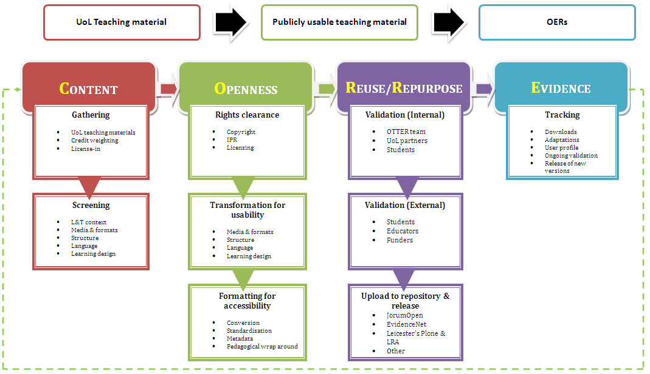
CORRE:
A framework for transforming teaching materials into OERs

Slide 11
OERs in JORUM
 | Title & URL | Subject | Type & Format | Views | Downloads
1 | Working with type: An overview of typographic and layout principles, http://find.jorum.ac.uk/resources/18511 | 2D Design | Tutorial in PDF | 76 (Since Jan) | 97 (Since Jan)
2 | How dark were the ‘Dark Ages’? – Early English Literature, http://find.jorum.ac.uk/resources/18526 | English & Creative Writing | PowerPoint presentation, Lecture | 146 (Since Feb) | 43 (Since Feb)
3 | Creating Myths, http://find.jorum.ac.uk/resources/18903 | English & Creative Writing | PowerPoint presentation & PDF, Exercise | 156 (Since Apr) | 35 (Since Apr)
4 | The political agenda: effect on service delivery, http://find.jorum.ac.uk/resources/18518 | Nursing | Learning activity in Word | 38 (Since Mar) | 14 (Since Mar)
5 | Patient/carer’s feedback to enhance learning for student Nurses, http://find.jorum.ac.uk/resources/18519 | Nursing | Assessment tool in Word | 42 (Since Feb) | 22 (Since Feb)
6 | Overview about fraud and risk factors, http://find.jorum.ac.uk/resources/18494 | Finance & Accounting | PowerPoint presentation, Lecture | 90 (Since Dec) | 52 (Since Dec)
7 | Social Earnings Ratio - S/E, http://find.jorum.ac.uk/resources/18904 | Social Enterprise | Tool in Excel | 90 (Since Apr) | 14 (Since Apr)

Slide 12
OERs in JORUM
 | Title & URL | Subject | Type & Format | Views | Downloads
8 | Properties of Ultrasonic Waves, http://find.jorum.ac.uk/resources/18755 | Engineering | Module material in Word | 45 (Since Mar) | 29 (Since Mar)
9 | Pollution and pollutants, http://find.jorum.ac.uk/resources/18529 | Environmental & Waste Management | Module material in HTML & Word | 71 (Since Feb) | 185 (Since Feb)
10 | Case studies in psychology ethics, http://find.jorum.ac.uk/resources/18520 | Psychology | Tutorial in Word | 39 (Since Feb) | 86 (Since Feb)
11 | Youth work: the role of the youth services in including young people with Special Educational Needs, http://find.jorum.ac.uk/resources/18536 | Youth & Community | PowerPoint presentation, Lecture | 31 (Since Jan) | 9 (Since Jan)
12 | Student-created presentations on contemporary global issues, http://find.jorum.ac.uk/resources/18898 | Sociology | PowerPoint presentations | 16 (Since Apr) | 41 (Since Apr)
13 | The UKPSF Self-Audit Tool, http://find.jorum.ac.uk/resources/18907 | CPD | Tool in PDF | 51 (Since Apr) | 13 (Since Apr)
14 | Skills Hub, http://find.jorum.ac.uk/resources/18539 | Study skills | Website | 66 (Since Feb)
*15 | Study Skills MOOC, http://cfap.coursesites.com | Study skills | MOOC

Slide 13
Evaluation
Evaluation of Phase 1 of the project will be conducted during July-August 2014
Academics who have contributed materials to Open Northampton
Personal interviews:
Perceived challenges and concerns over open practices
Views on the impact of openness on their teaching practice
Image from Pixabay, Public Domain

Slide 14
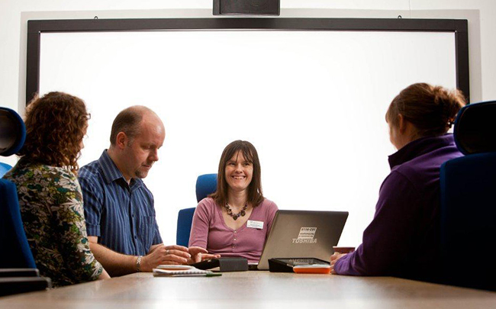
Contribute more when seeing the benefits
Openness is seen as the School priority
What works?
Image by Kingroyos, Wikimedia Commons, CC BY-SA
Image by Capture Queen â„¢ CC BY
Transforming a course into online or blended
Developing a new course

Slide 15
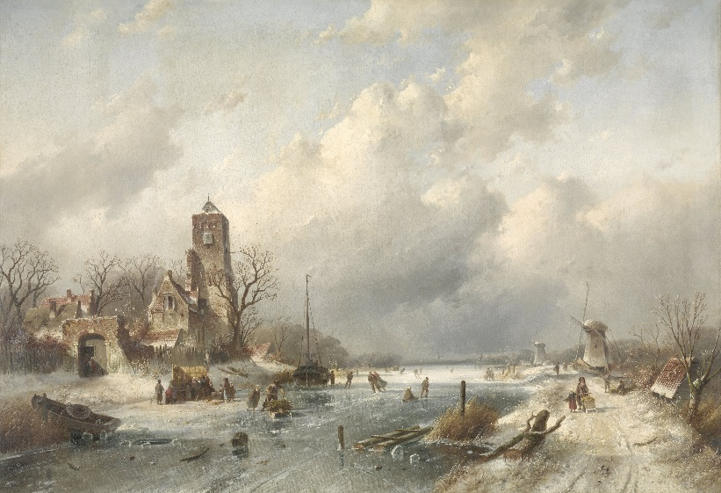
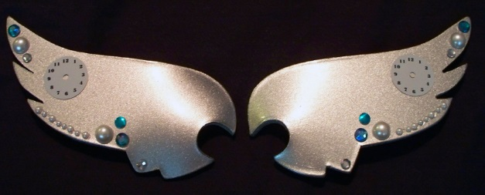
What’s been challenging?
Use images of design and artworks
Use of diagrams, figures, screenshots
Image from RIJKSSTUDIO, Public Domain
Image from Pixabay, Public Domain
Don’t want to give away the ‘family silver’
Image from http://ljvaughn.deviantart.com/art/Steampunk-Wings-in-Silver-131913368, CC BY-NC-ND

Slide 16
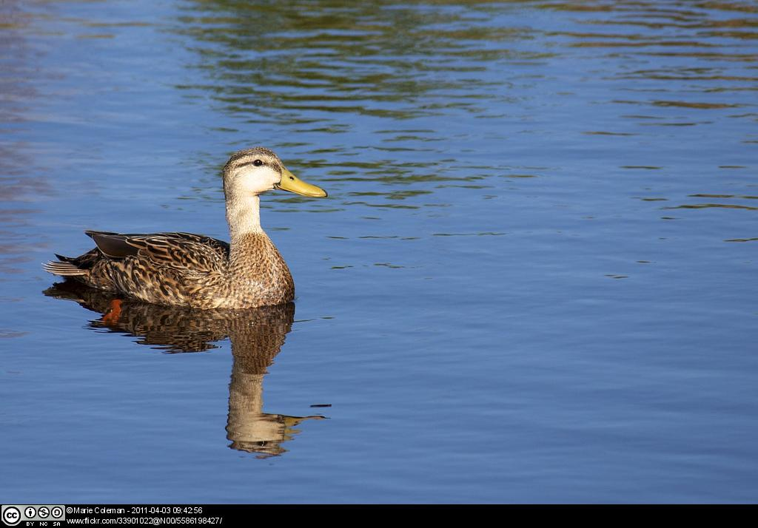
Open
Northampton
Please contact:
Dr Ming Nie
Ming.Nie@northampton.ac.uk
Prof Alejandro Armellini
Ale.Armellini@northampton.ac.uk
Institute of Learning and Teaching in HE
http://www.northamptonilt.com/open-northampton

